Slide 1
Machine Learning for Predicting Hospital Readmission
Yung Chou
12/12/2018

Slide 2
Agenda
Motivation
Data Set
Data Preparation
Machine Learning Model
Results
Lessons Learned

Slide 3
Motivation
Personal interests
Relevance
Indication to health care quality and a patient’s experience
Interpretation and implementation
Public health
Hospital Readmissions Reduction Program (HRRP)
Center for Medicare & Medicaid Services (CMS)
An important and on-going topic
Long-term health care quality and cost-effectiveness

Slide 4
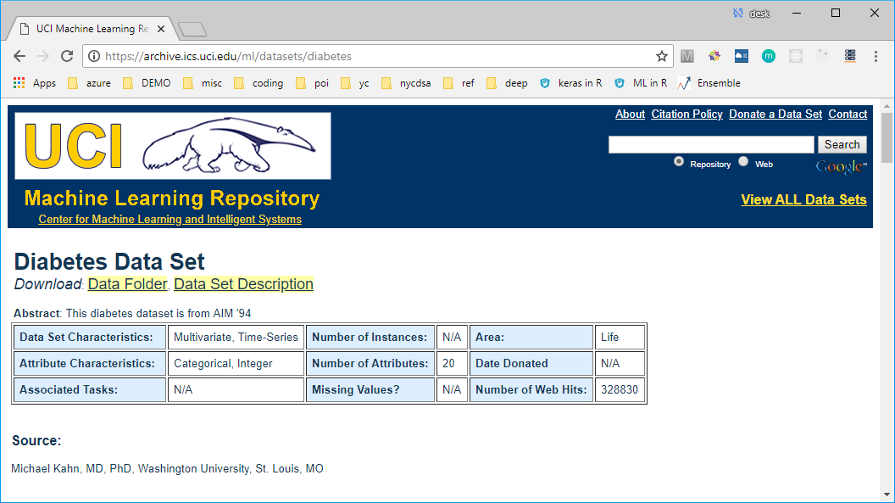
Data Set

Slide 5
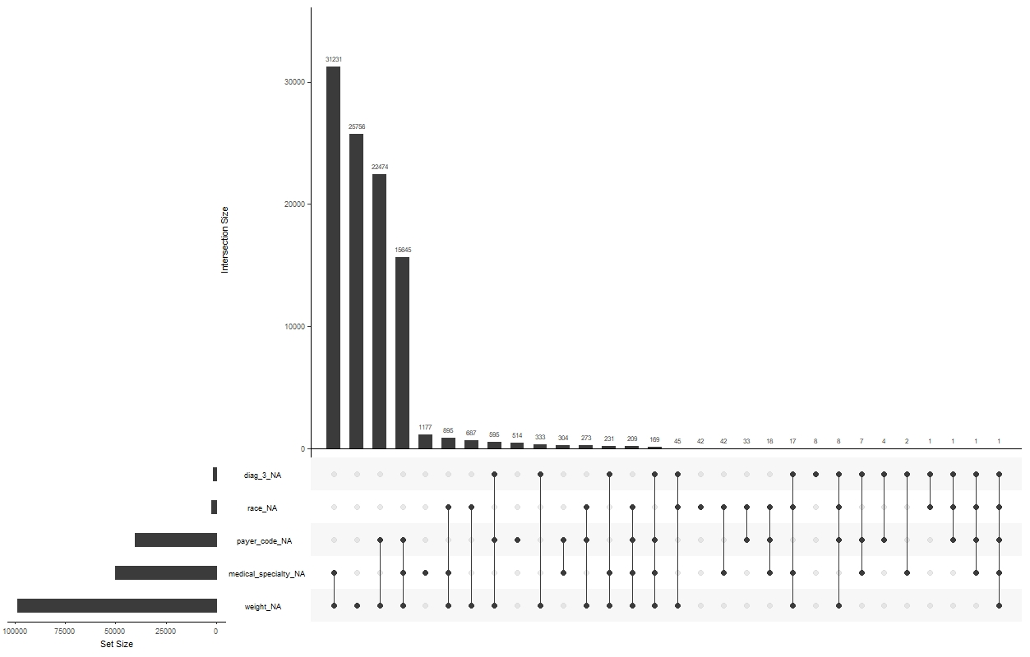
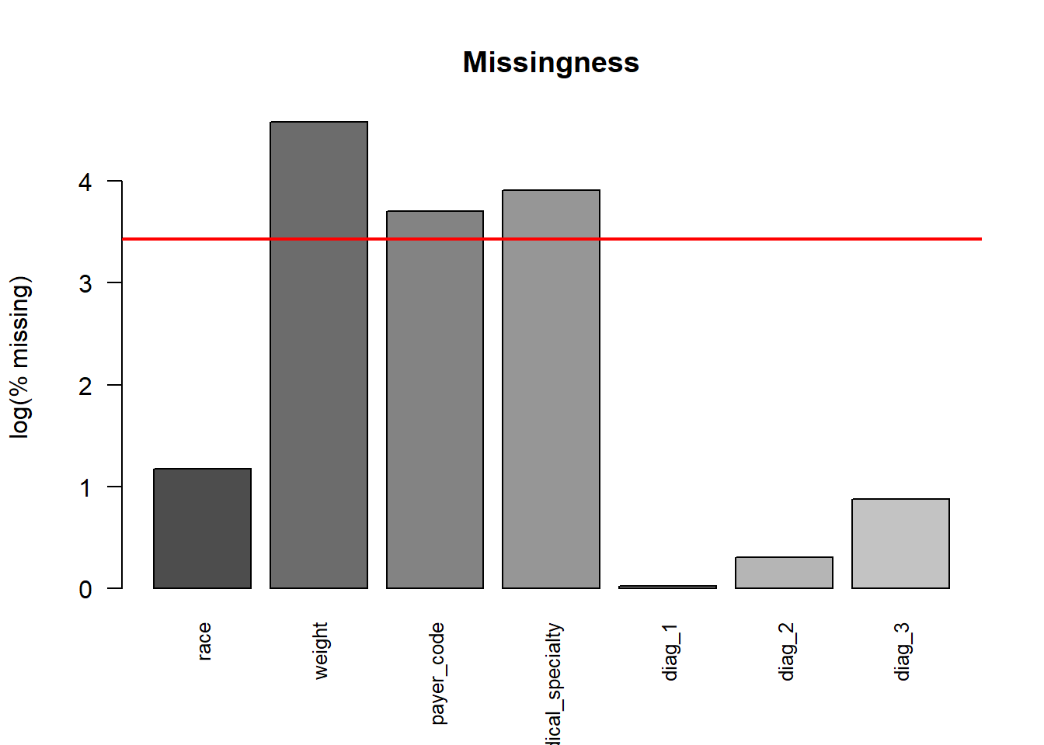
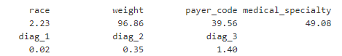
Missingness
Percentage of missing values

Slide 6
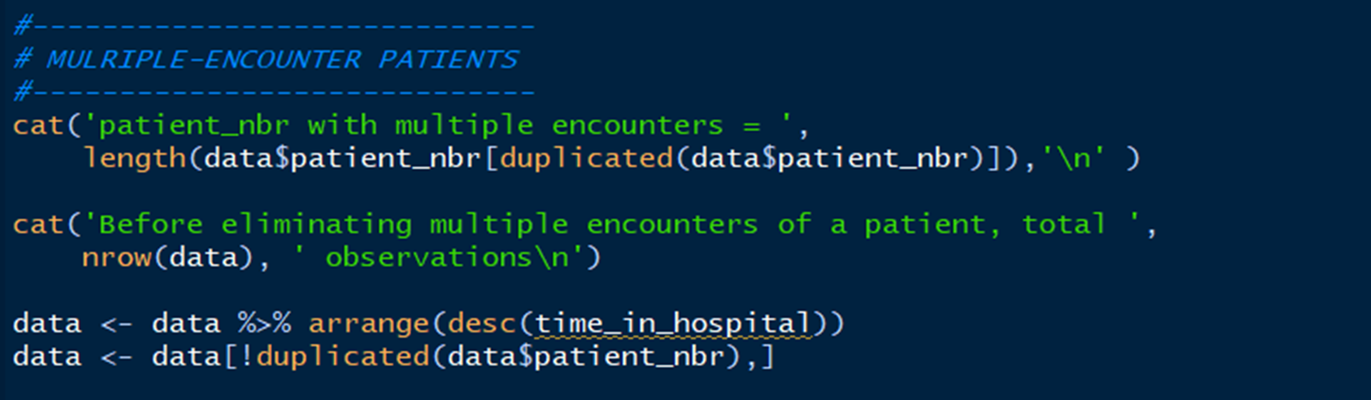
Near zero-variance variables
Multiple-encounter patients

Slide 7
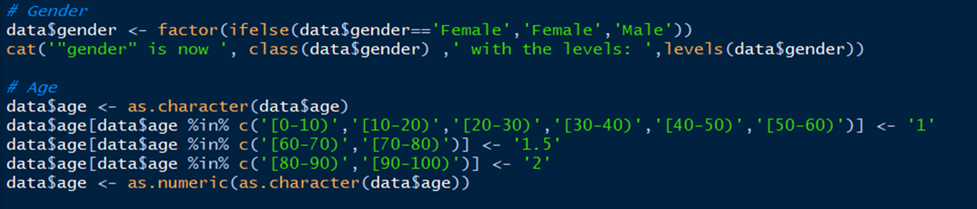
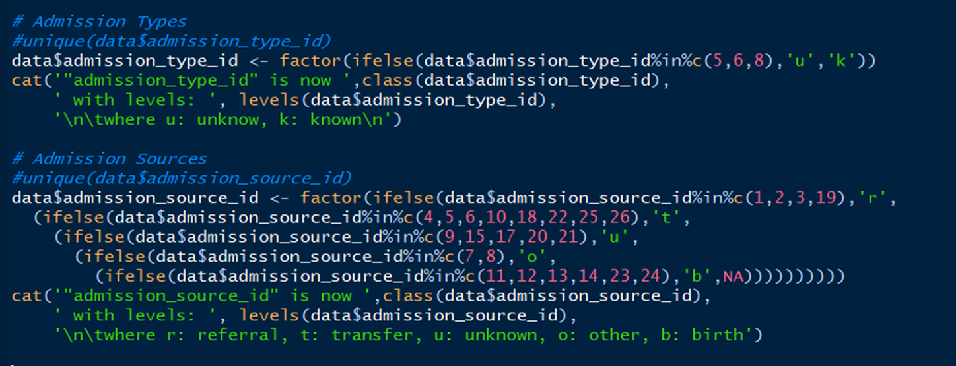

Slide 8
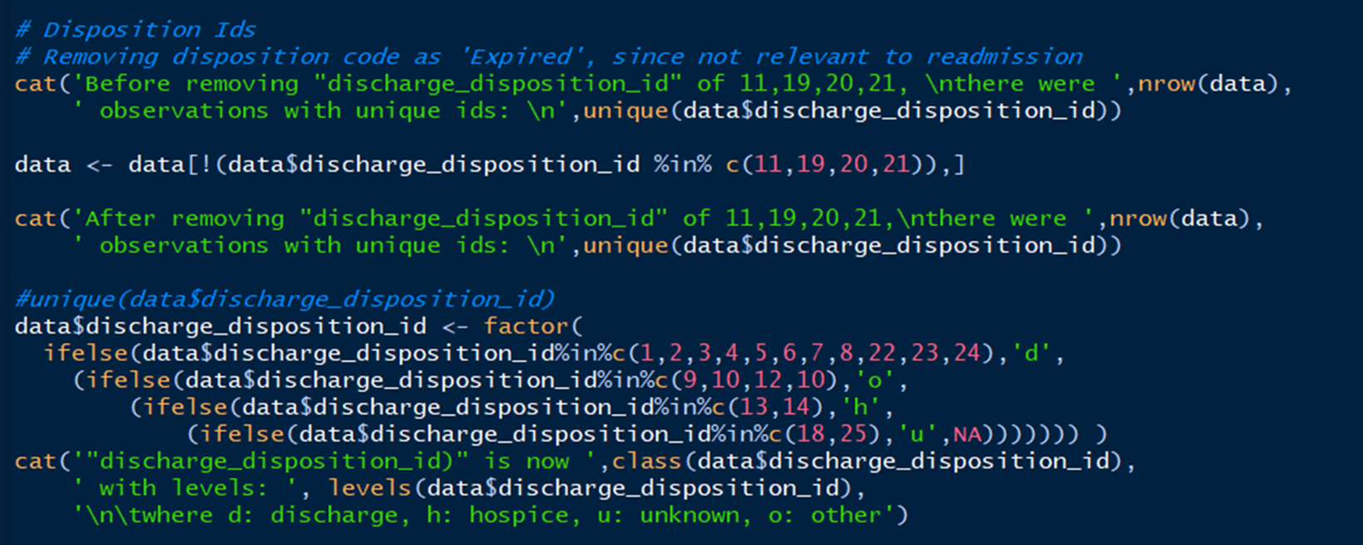

Slide 9
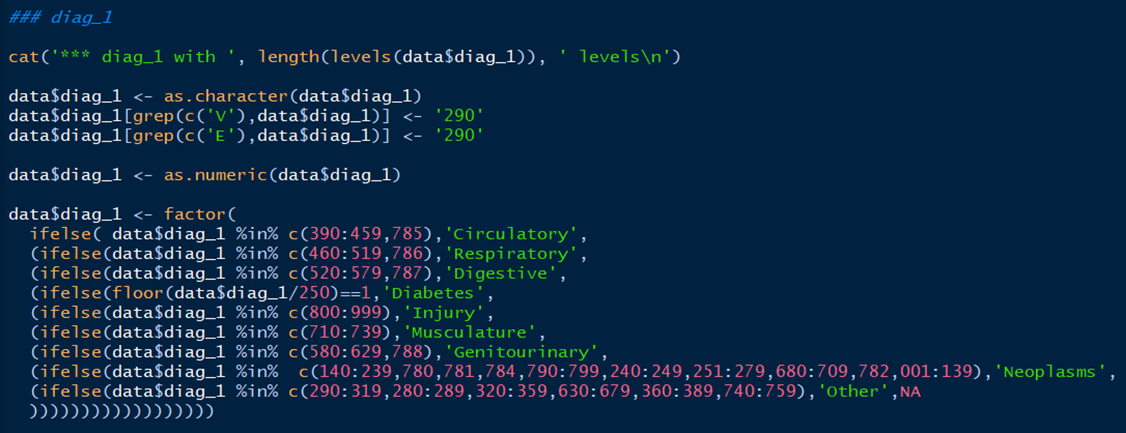
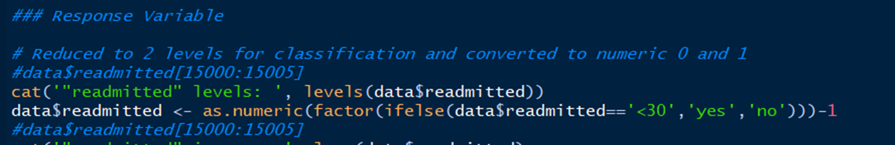

Slide 10
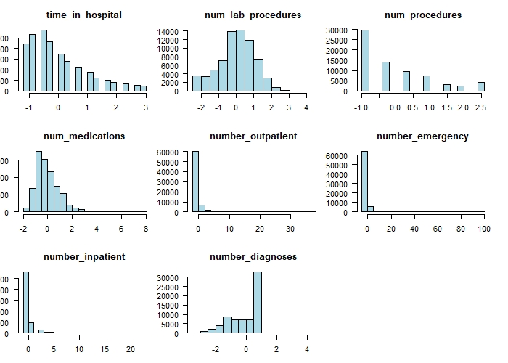
Numeric variables

Slide 11
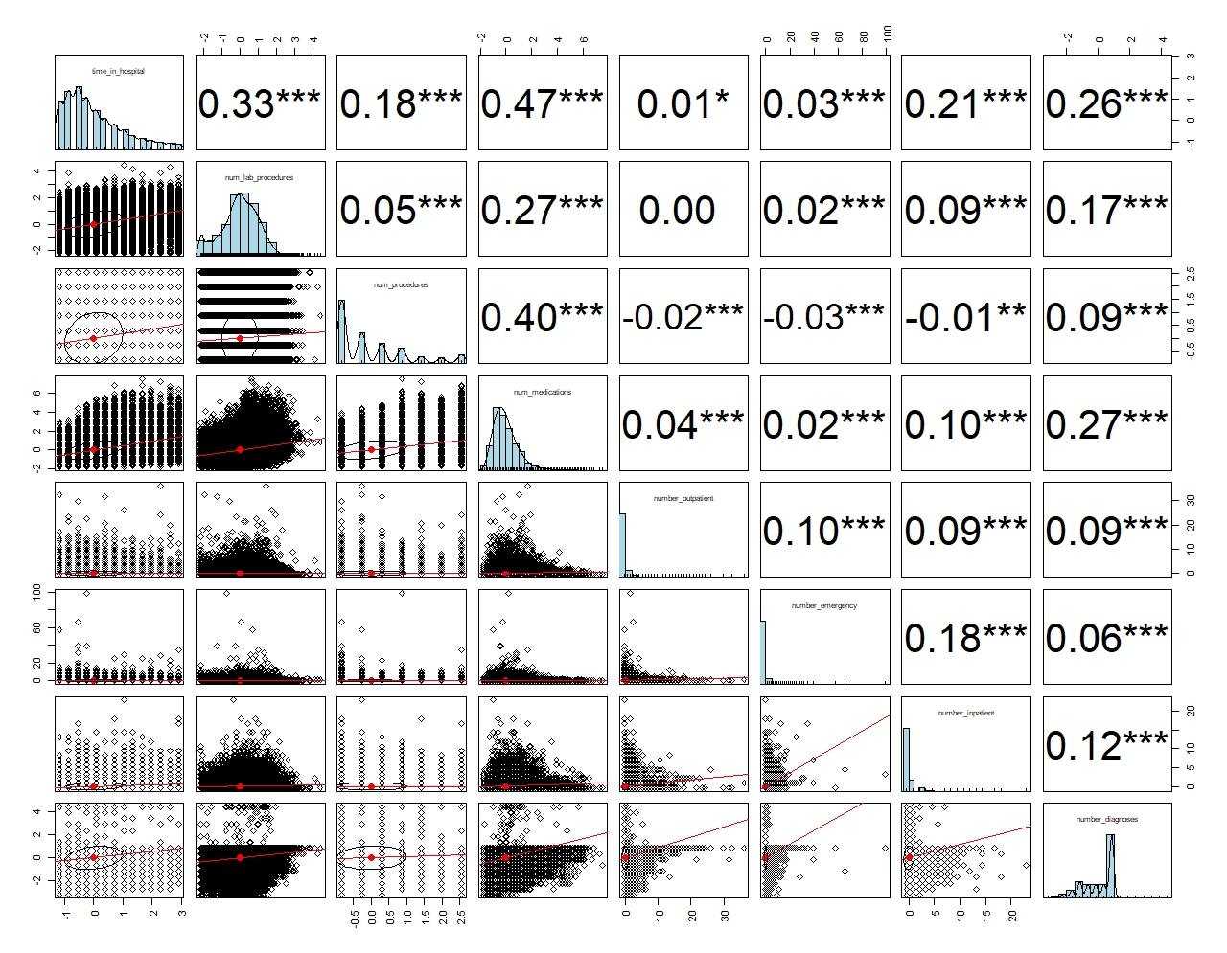

Slide 12
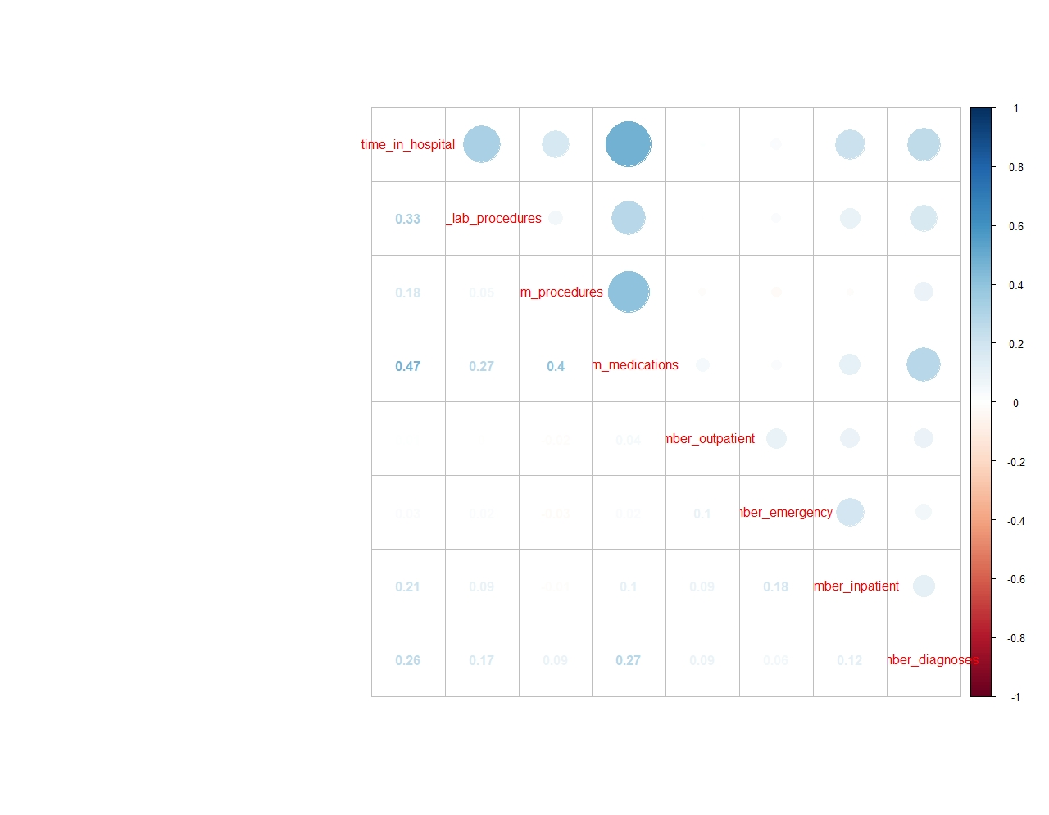

Slide 13
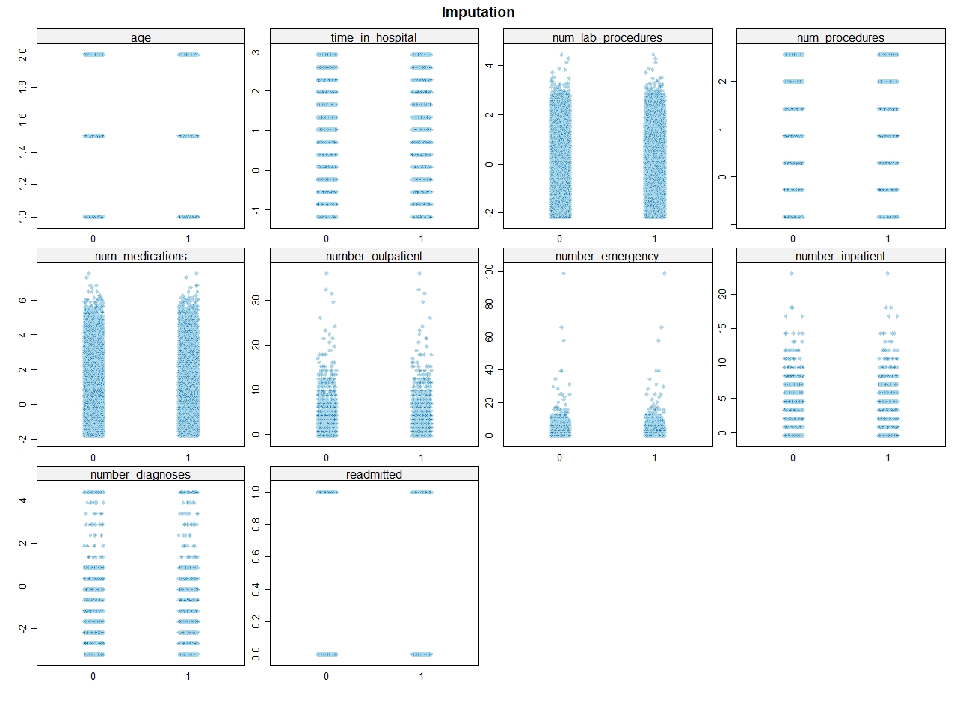

Slide 14
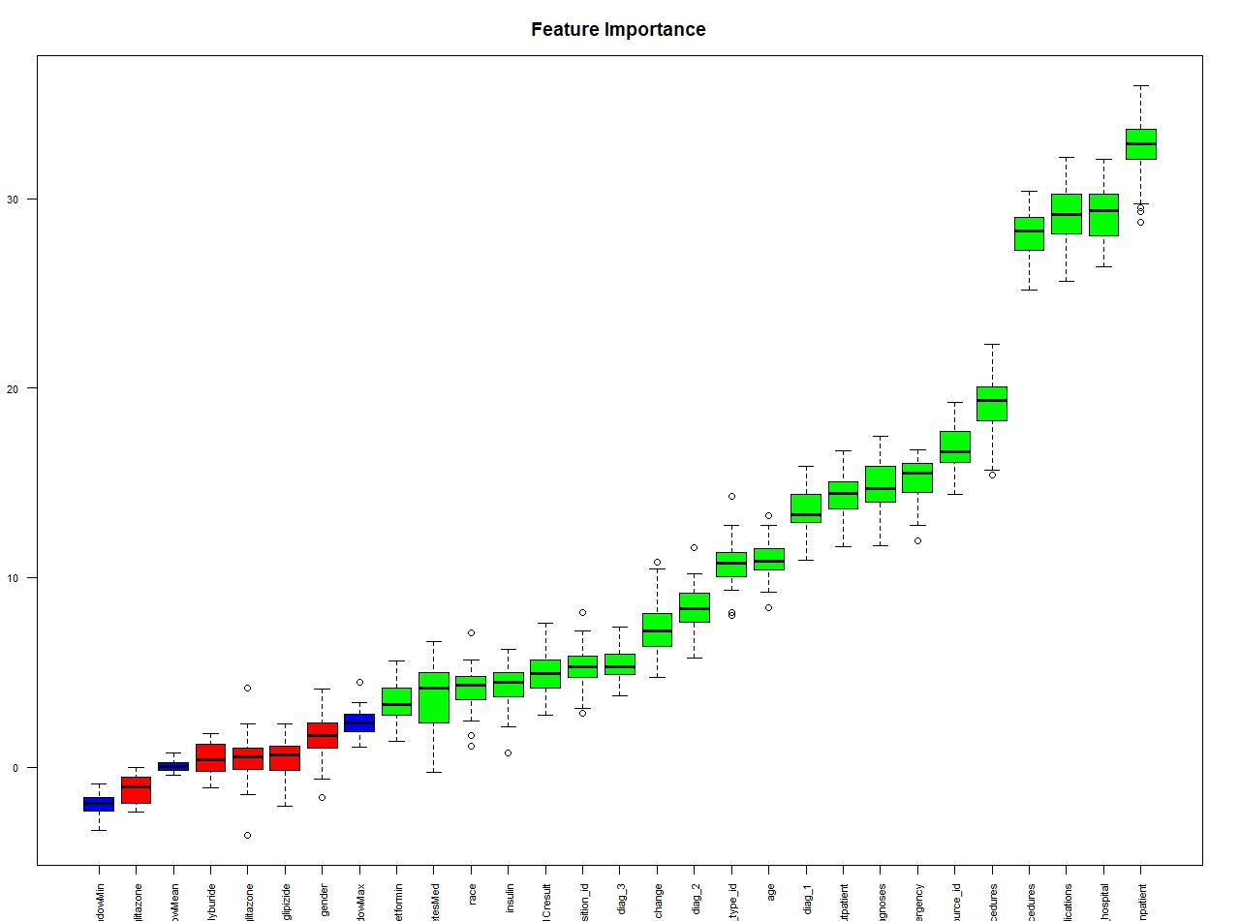
Boruta selected features
"race“
"age“
"admission_type_id" "discharge_disposition_id" "admission_source_id" "time_in_hospital"
"num_lab_procedures" "num_procedures" "num_medications"
"number_outpatient" "number_emergency" "number_inpatient"
"diag_1“
"diag_2“
"diag_3"
"number_diagnoses"
"A1Cresult“
"metformin"
"insulin“
"change“
"diabetesMed"

Slide 15
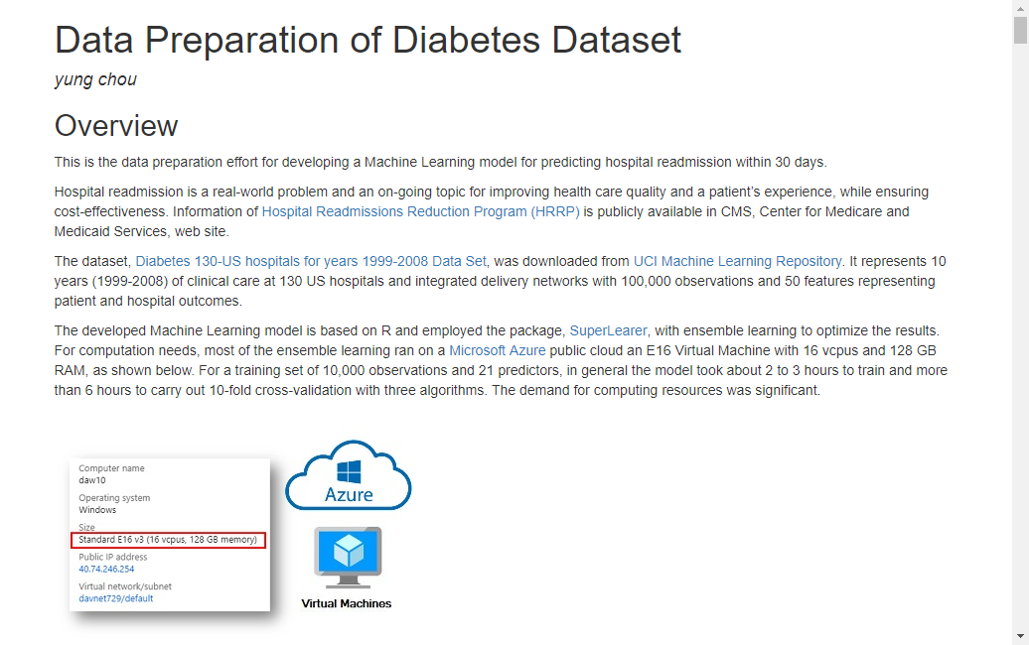
http://yungchou.github.io/site

Slide 16


Slide 17

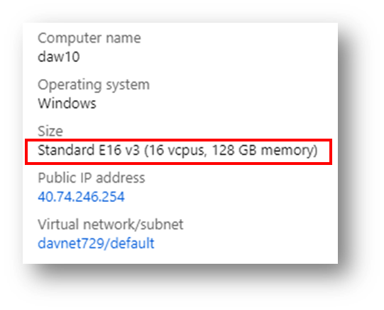

Machine Learning
SuperLearner
Various algorithms
Ensemble models

Slide 18
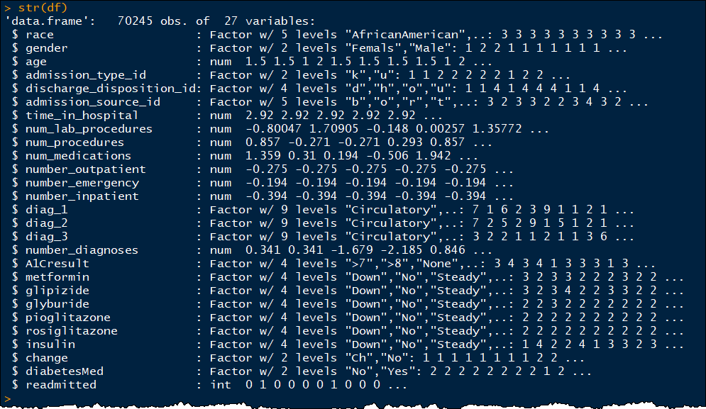

Slide 19
RandomForest
when you are down and out

Slide 20
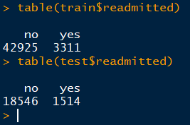
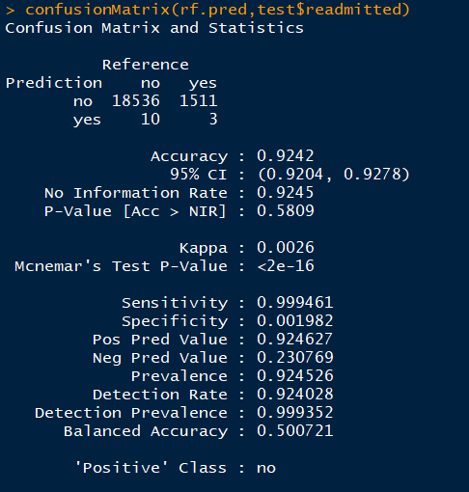
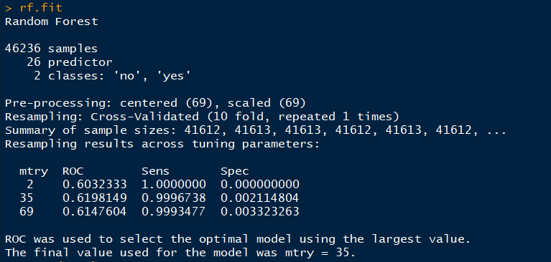
66K, 70/30 split
There must be a message…

Slide 21
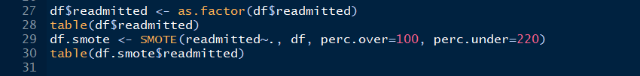
SMOTE
Highly unbalanced data
SMOTE (Chawla et. al. 2002)
To artificially generate new examples of the minority class
The majority class examples also under-sampled, leading to a more balanced dataset

Slide 22
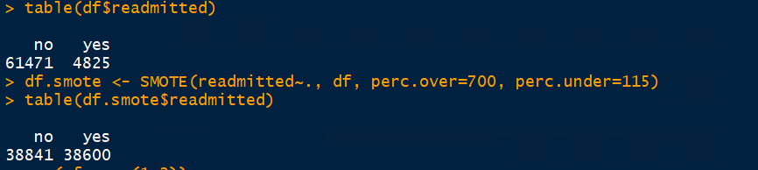
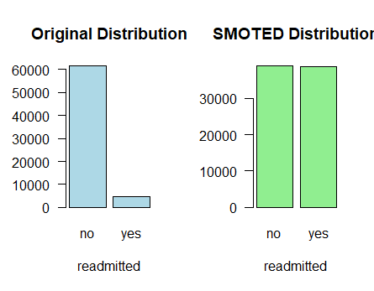

Slide 23
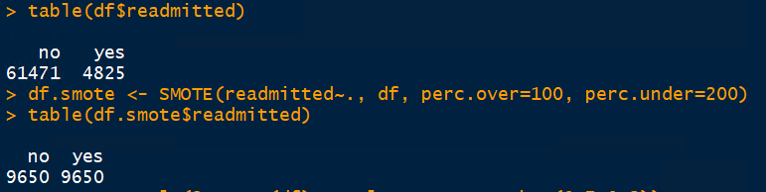
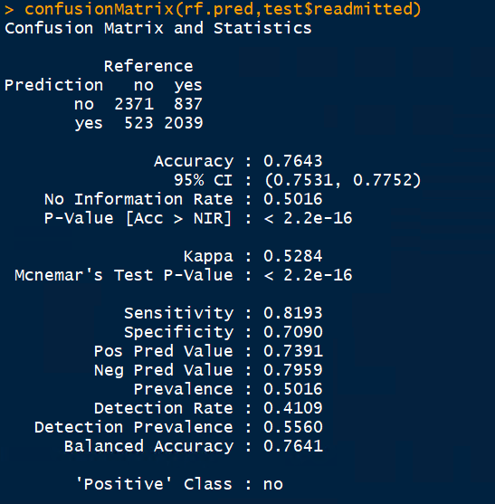
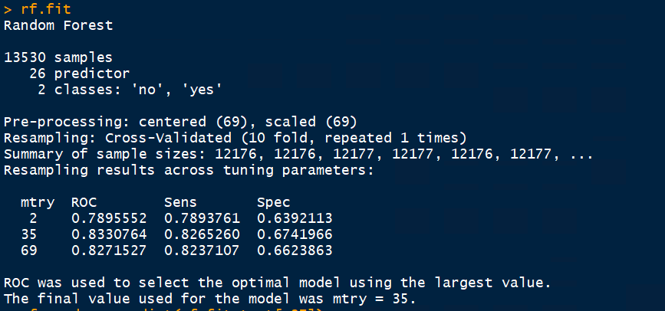
smote data
method = ‘rf’
10-fold cv

Slide 24
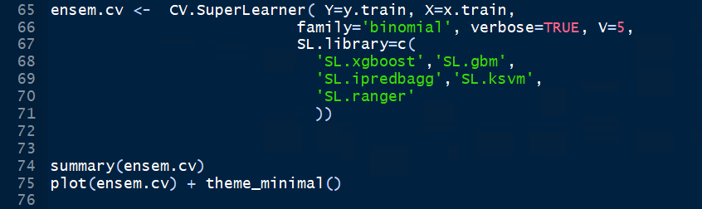
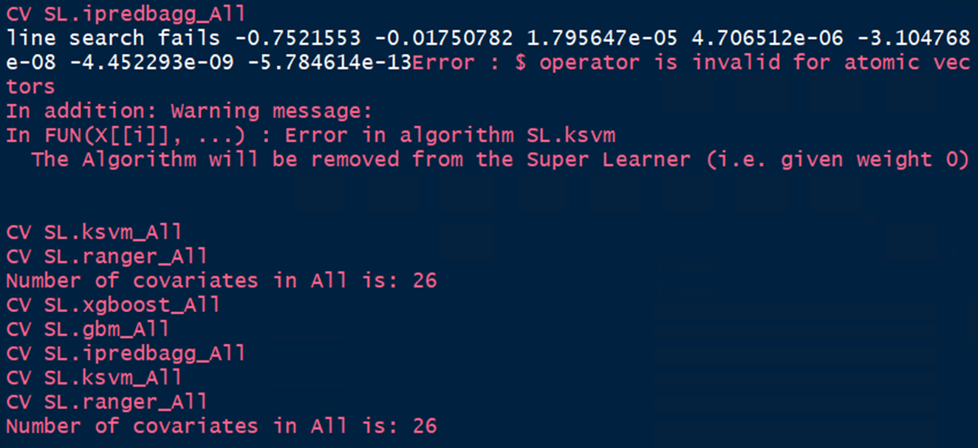
Ensemble Learning

Slide 25
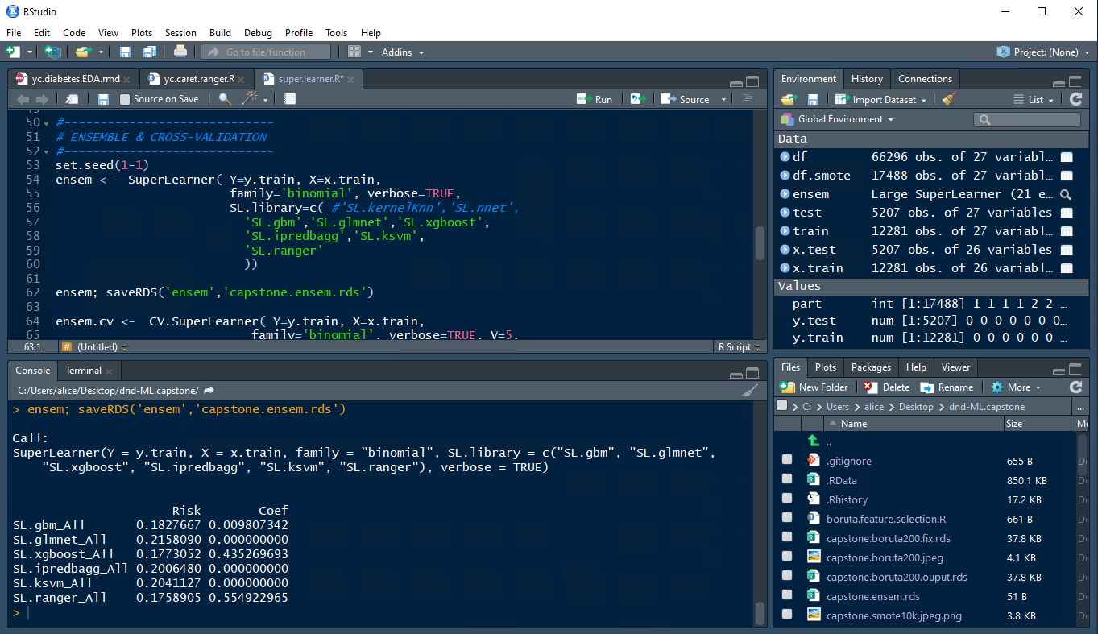

Slide 26
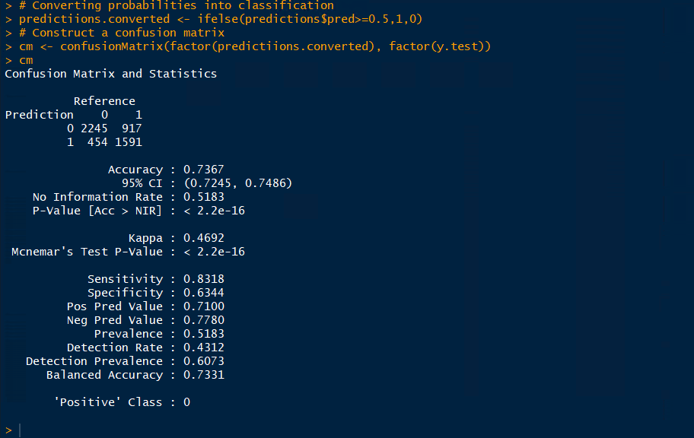
5K, 70/30 split

Slide 27
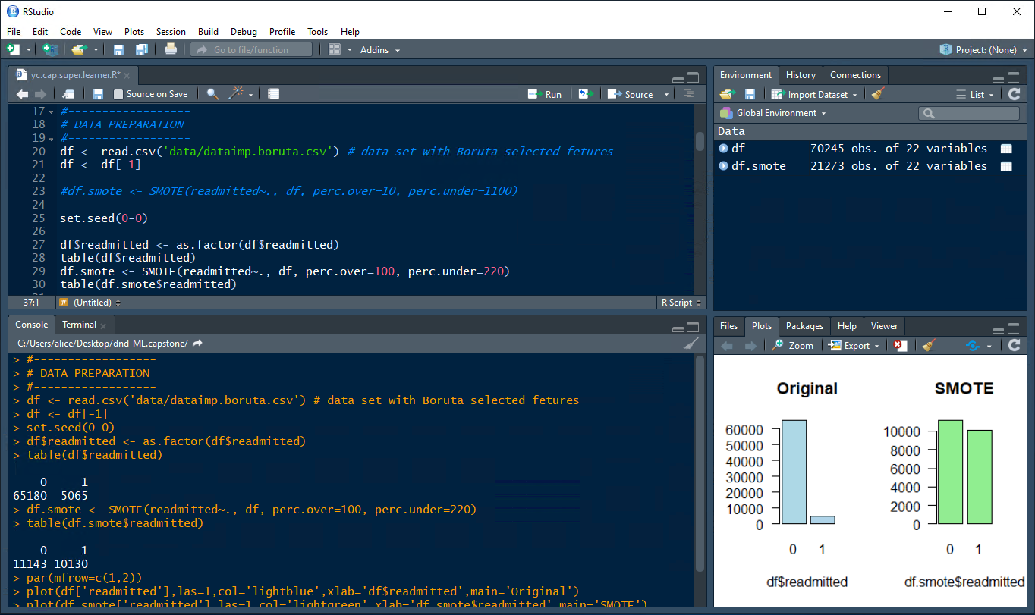
Increased samples 4 times to 20K

Slide 28
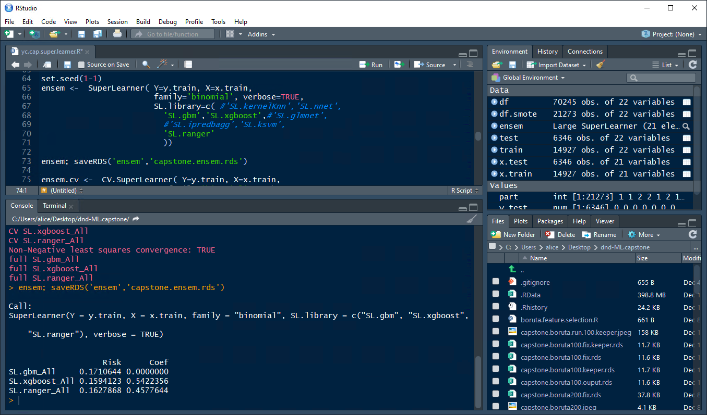
Dropped
ipredbagg, skm, glmnet

Slide 29
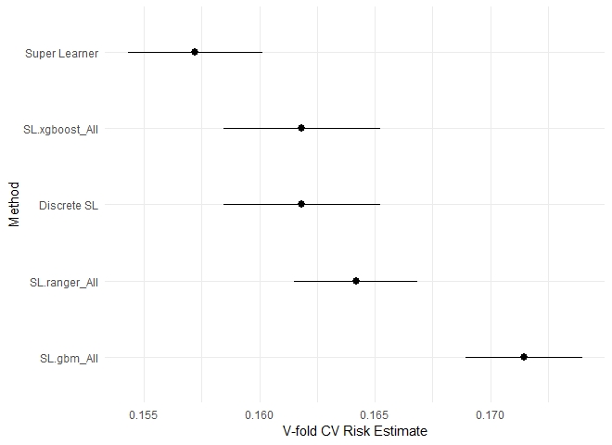

Slide 30
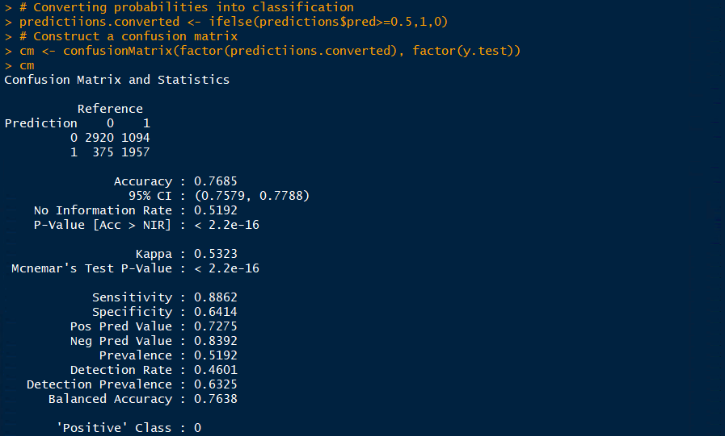

Slide 32



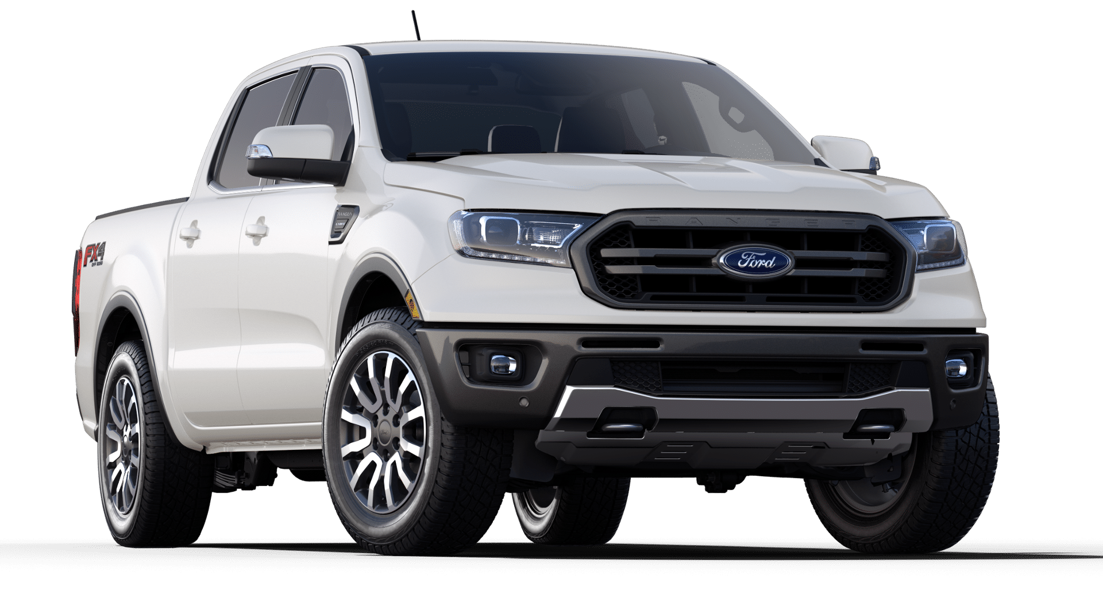
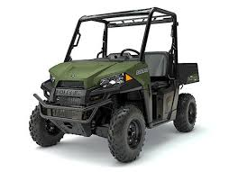

Slide 33
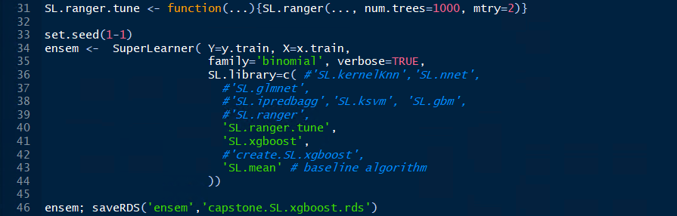
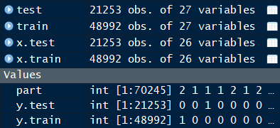
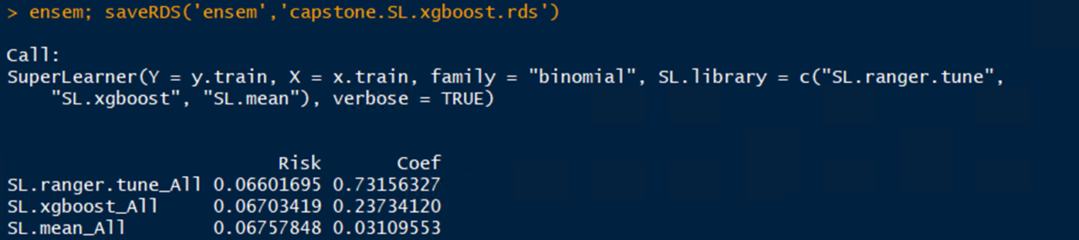
Tuning Ranger
Notes:
The training ran about 3 hours with the cloud vm,14 vcpus
not with smote data.

Slide 34
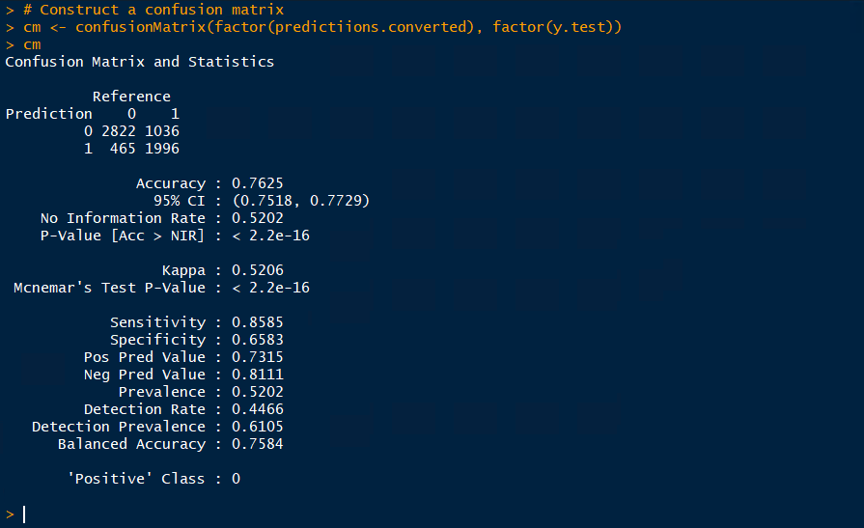

1st run
6K, 70/30
num.trees = 500
mtry = 5
V = 3

Slide 35
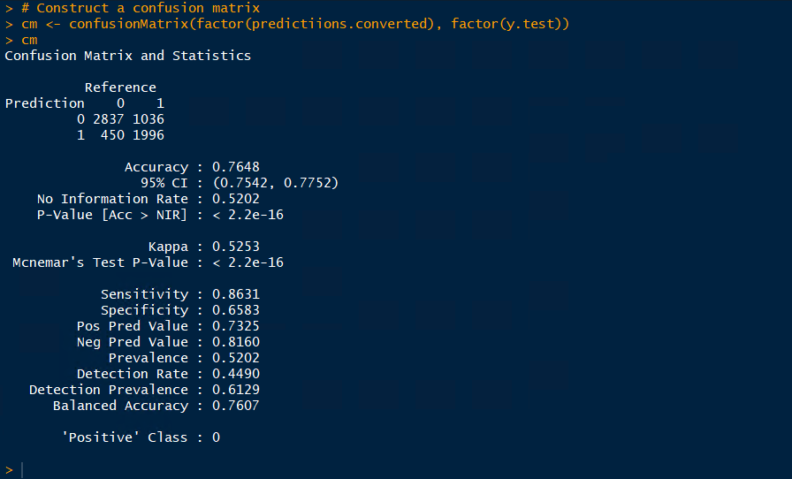
2nd run
6K, 70/30
num.trees = 1000
mtry = 5
V = 3

Slide 36
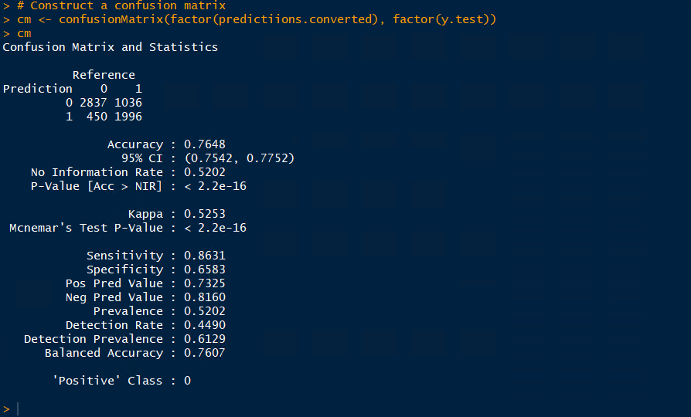
3rd run
num.trees = 1000
mtry = 5
V = 10

Slide 37
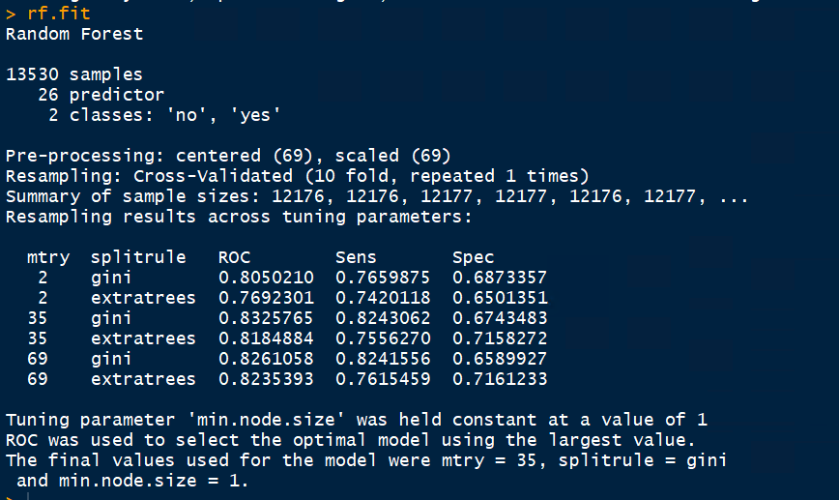
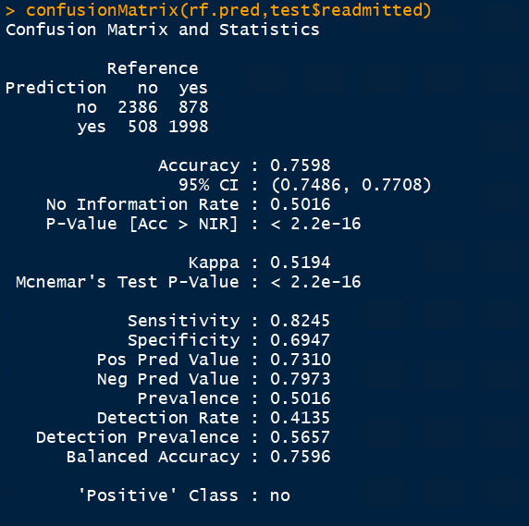
13K, 60/40 split
method = ‘ranger’
default settings
10-fold cv

Slide 38
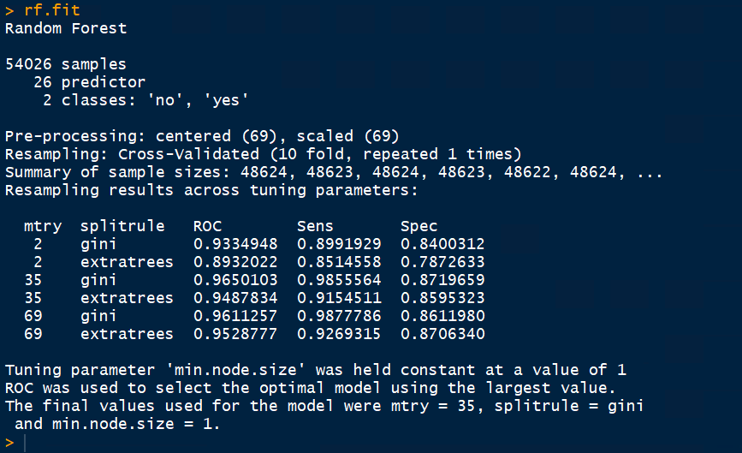
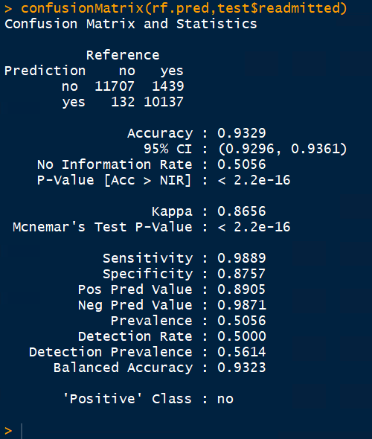
54K, 60/40 split
method = ‘ranger’
default settings
10-fold cv
One… small step… for man…

Slide 39
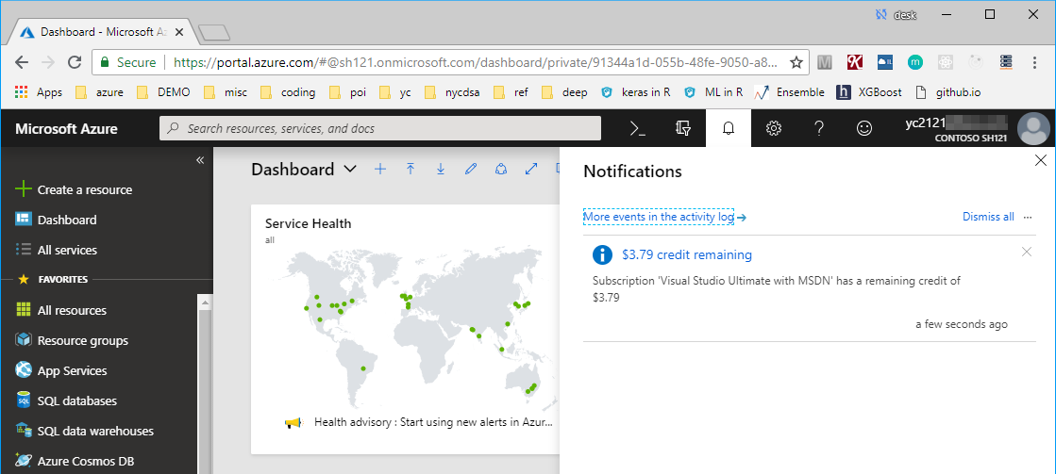

$3.79 left

Slide 40
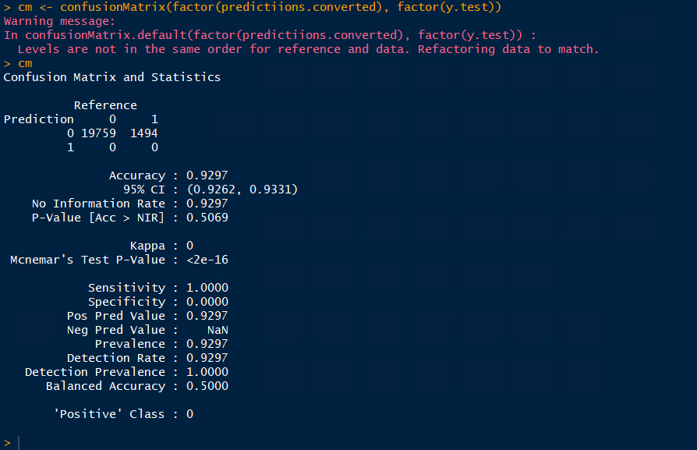
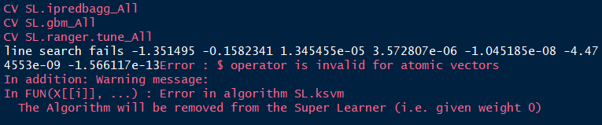
To SuperLearn, or Not to SuperLearn
Data issus when trying to predict
after a few hours of running

Slide 41


Lessons Learned
Predicting hospital readmissions with Machine Learning
A meaningful step to solve a complex problem
It does provide some insight of the service quality and a patient’s experience
Relevant to real world problem solving and warrant more efforts
Data cleaning is tedious, yet at the end it pays off
SMOTE is so hot, it’s cool
Hello Ranger and good riddance RandomForest
Computing power was critical for productivity
I would like to underfit something at some point of time
Hyperparameters, there’s a reason why they are called ‘hyper’
Ensemble model = practices + practices + more practices
So many tools, so little time
Pick just a few and make some lemonade
Running code is a pass, interpretation the gig
I’M IN

Slide 42
Thank you

Slide 43

Ensemble Learning

Slide 44



Slide 45


Slide 46


Slide 47


Slide 48

Ensemble Learning

Slide 49




Slide 50






Slide 51


Slide 52


Slide 53


Slide 54


Slide 55



SuperLearner
CV.SuperLearner

Slide 56


Slide 57




Slide 58


Slide 59


Slide 60


Slide 61


Slide 62


Slide 63



Slide 64


Slide 65




Slide 66


Slide 67


Slide 68


